Slide 1

Table of Contents
CREDIT DELINQUENCY
June 07 , 2024
02
INTRODUCTION
03
SIMPLIFIED MACHINE LEARNING MODEL
04
METHODOLOGY
05
EXPLORATION AND FEATURE ENGINEERING
07
SOLUTION
10
DEPLOYMENT
11
WHY USE DATAIKU
12
CONCLUSION
Notes:
© Copyright PresentationGO.com – The free PowerPoint and Google Slides template library

Slide 2





INTRODUCTION
PROBLEM
WHY
The credit delinquency of borrowers leads to financial losses and heightened operational expenses, as their failure to repay loans punctually adversely affects the enterprise's profitability and reputation in the financial market.
Financial Impact: Increases costs and delays cash flow due to unpaid amounts and collections efforts.
Operational Burden: Requires significant time and effort for managing delinquent accounts.
Reputation Risk: Signals financial instability and poor risk management, affecting trust.
SOLUTION
Develop Predictive Model & Application: Create a Machine Learning model for predicting credit delinquency over the next two years and an application for credit analysts to easily use the model.
Enhance Predictive Capabilities & Root Cause Analysis: Enable anticipation of clients' financial status and analyze patterns to understand and address the root causes of delinquency.
STAKEHOLDERS
CONSTRAINTS
Credit Risk Management Team
IT Department
Legal Department
Customer Service Representatives
Accurate Data & Early Detection: Obtain precise borrower information and identify delinquency signs promptly.
Cost-Effective & User-Friendly: Implement valuable, simple, and easy-to-use solutions.
Compliance & Scalability: Ensure adherence to regulations and develop systems that efficiently manage increasing volumes of delinquent accounts.

Slide 3







SIMPLIFIED MACHINE LEARNING MODEL
A Machine Learning classification model is a program that uses features (input variables) to predict a target (output variable).
This program is developed through a « Training » process that uses labeled historical data (features and target) to build the model (the program and its metadata). Once trained, the model can be used to predict the target based solely on the features.
TRAIN DATA
FEATURES
PROGRAM
MODEL
TRAINING
TRAIN DATA
TARGET
TEST DATA TARGET
(GROUND TRUTH)
TEST DATA FEATURES
(NOT YET SEEN)
MODEL
PREDICTION PERFORMANCE
SCORE
TESTING
COMPARE
PREDICTED TARGET

Slide 4

METHODOLOGY
The business problem can be modeled as a binary classification model. This involves creating a machine learning model capable of predicting the class (1 for a customer in credit delinquency, 0 otherwise) based on the input features.
This model will then be used to develop an application to predict which customers might be in credit delinquency and to understand the patterns leading to such situations.
EXPLORE DATA
FEATURE ENGINEERING
MODEL
INTERPRETATION
DEPLOYMENT
Collecting and cleaning data to ensure its quality, then using statistical methods and visualization tools to understand its characteristics and identify patterns, relationships, and anomalies that can inform the modeling process.
Feature engineering involves creating and refining variables from raw data to improve model accuracy, including generating new features, transforming data, and selecting the most impactful variables. This step is crucial for enhancing the model's learning and predictive capabilities.
Train a model on prepared data to identify patterns and make predictions, including selecting the relevant algorithm, splitting data into training and validation sets, tuning hyperparameters, and evaluating performance with metrics to ensure accuracy and reliability.
Understand and explain the model’s predictions by analyzing which features most influence the outcomes, using tools like SHAP to provide transparency and insights into the model's decision-making process, ensuring it is trustworthy and actionable.
Deploy the model and design a simple and user-friendly application that allows users to make predictions and understand patterns.

Slide 5
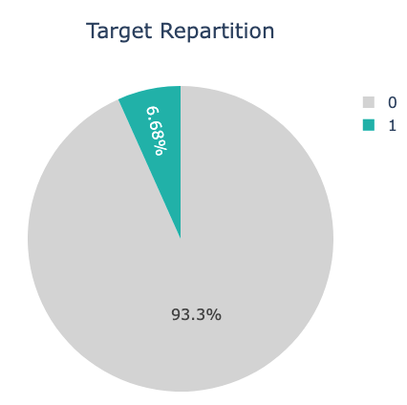
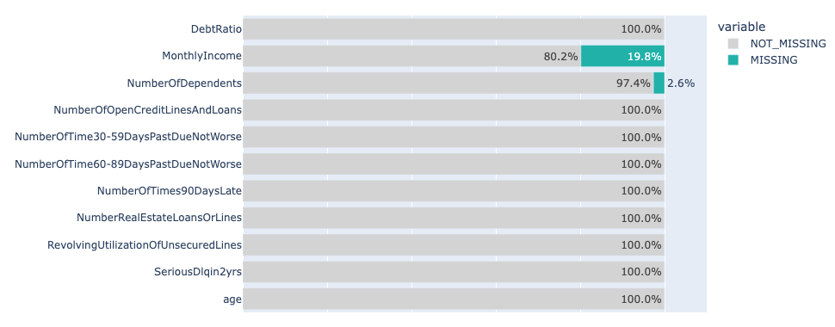
EXPLORATION AND FEATURE ENGINEERING (1/2)
The objective of this step is to analyze the data we have to assess its quality and choose the right approach to address the problem and enhance the performance of the model we aim to create.
TARGET REPARTITION
MISSING VALUES
We should treat imbalanced data because it can lead to biased model performance, where the model may favor the majority class and neglect the minority class, resulting in poor generalization and prediction accuracy
Missing values can introduce bias and reduce the effectiveness of our models; by handling them appropriately, we can maintain the integrity and accuracy of our analyses.
In this case, we use a resampling technique that consists of reducing the size of the majority class in a dataset to balance it with the minority class.
We use some specific Machine Learning Models (Random Forest, le Gradient Boosting) known to be efficient on imbalanced data.
We will use an imputation technique that involves estimating and replacing missing values with plausible substitutes based on available information within the dataset.
We use adequat Machine Learning models that handle missing data effectively.

Slide 6
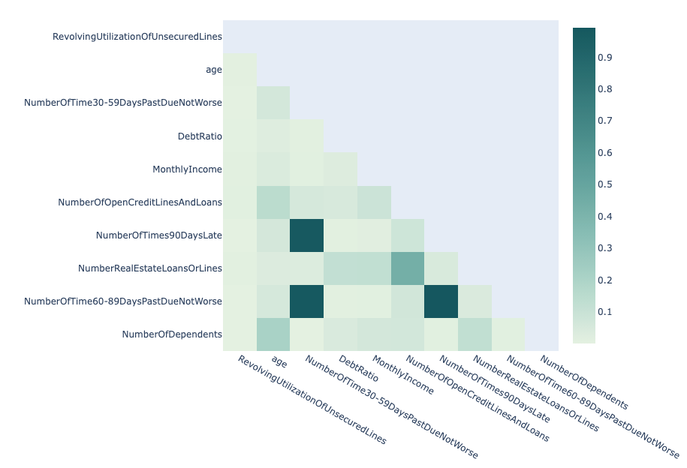
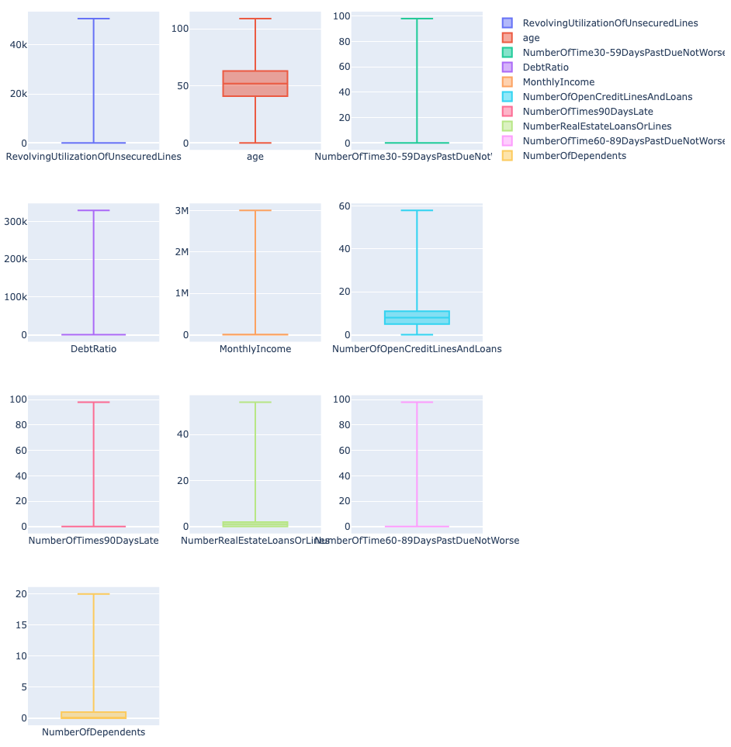
EXPLORATION AND FEATURE ENGINEERING (2/2)
CORRELATION
FEATURES RESCALING & OUTLIERS
Taking feature correlation into account is important to avoid multicollinearity problems, which can adversely affect model performance and compromise its interpretation and reliability.
Rescaling data and avoiding outliers helps ensure that each feature contributes equally to the model's learning process and prevents disproportionately influential data points from skewing the results.
We should perform feature selection to keep only the most informative features.
Use algorithms that are robust to correlated features such as tree-based models like Random Forests or Gradient Boosting.
We will use a ready rescaling tool that transforms data in a way that makes it easier for machine learning algorithms to work with by putting each feature on the same scale.

Slide 7









SOLUTION – ML MODEL (1/3)
PERFORMANCE ON TEST DATA
(NOT SEEN YET)
LightGBM Model
85%
AUC
AUC of 85% indicates that the model has a high level of accuracy in distinguishing between delinquent and non-delinquent classes.
01 - Accurate
05 - Robust to features correlation
LightGBM achieves high prediction accuracy by effectively capturing complex data patterns.
It reduces the impact of correlated features, avoiding redundant information.
47%
08
02 - Non-overfitting
07
06 - Robust to non-scaled data
RECALL
The model correctly identifies 47% of all true delinquent cases.
It incorporates regularization techniques that prevent the model from overfitting to the training data.
01
It works well with features that are not normalized or standardized.
02
06
03 - Adapted to imbalanced data
07 - Cost-effective
It handles imbalanced datasets efficiently by adjusting weights during training.
03
05
Efficient in terms of computational resources and training time
41.5%
04
PRECISION
41.5% of the borrowers the model flags as delinquent are truly delinquent.
04 - Robust to missing values
08 - Interpretable
handle datasets with missing values without requiring imputation.
It provides clear insights into feature importance, aiding in model interpretability and decision-making.

Slide 8
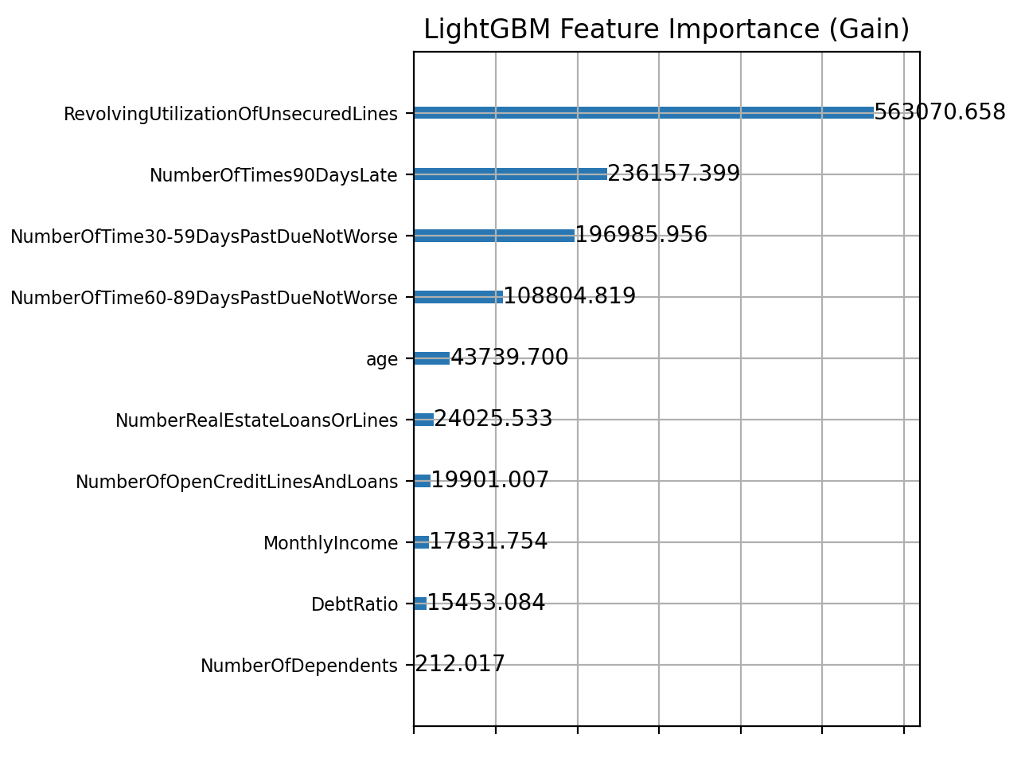
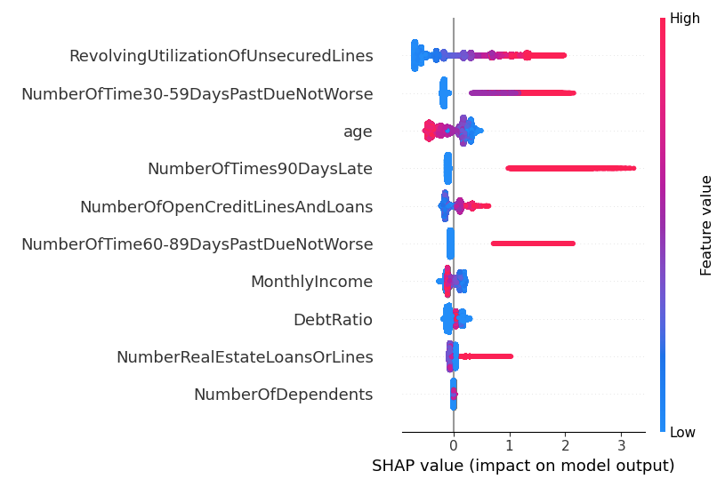
SOLUTION – ML MODEL (2/3)
INSIGHTS
Example of three important features:
RevolvingUtilizationOfUnsecuredLines: The more a person exceeds their credit limits, the higher the probability they will default in the next two years.
NumberOfTimes90DaysLate: An increase in the number of times the borrower has been 90 days or more delinquent substantially raises the probability of default.
NumberOfTime30-59DaysPastDueNotWorse: The number of times the borrower has been 30 to 59 days late, but not worse, in the past two years significantly increases the likelihood of default.
Example of two insignificant features
NumberOfDependents: The number of dependents does not significantly impact the probability of default.
MonthlyIncome: Monthly income is not a determining factor in the likelihood of default.

Slide 9
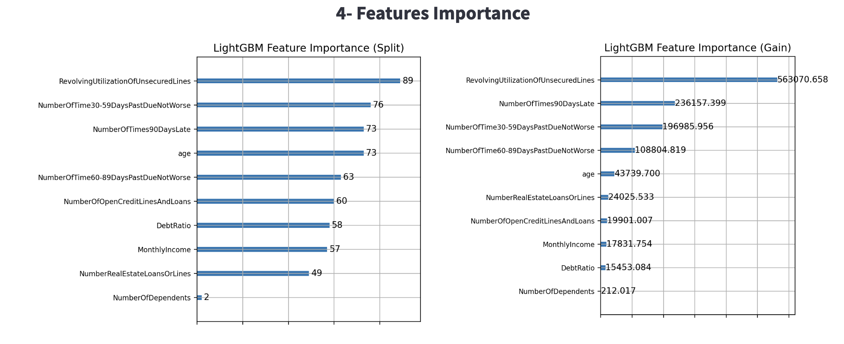
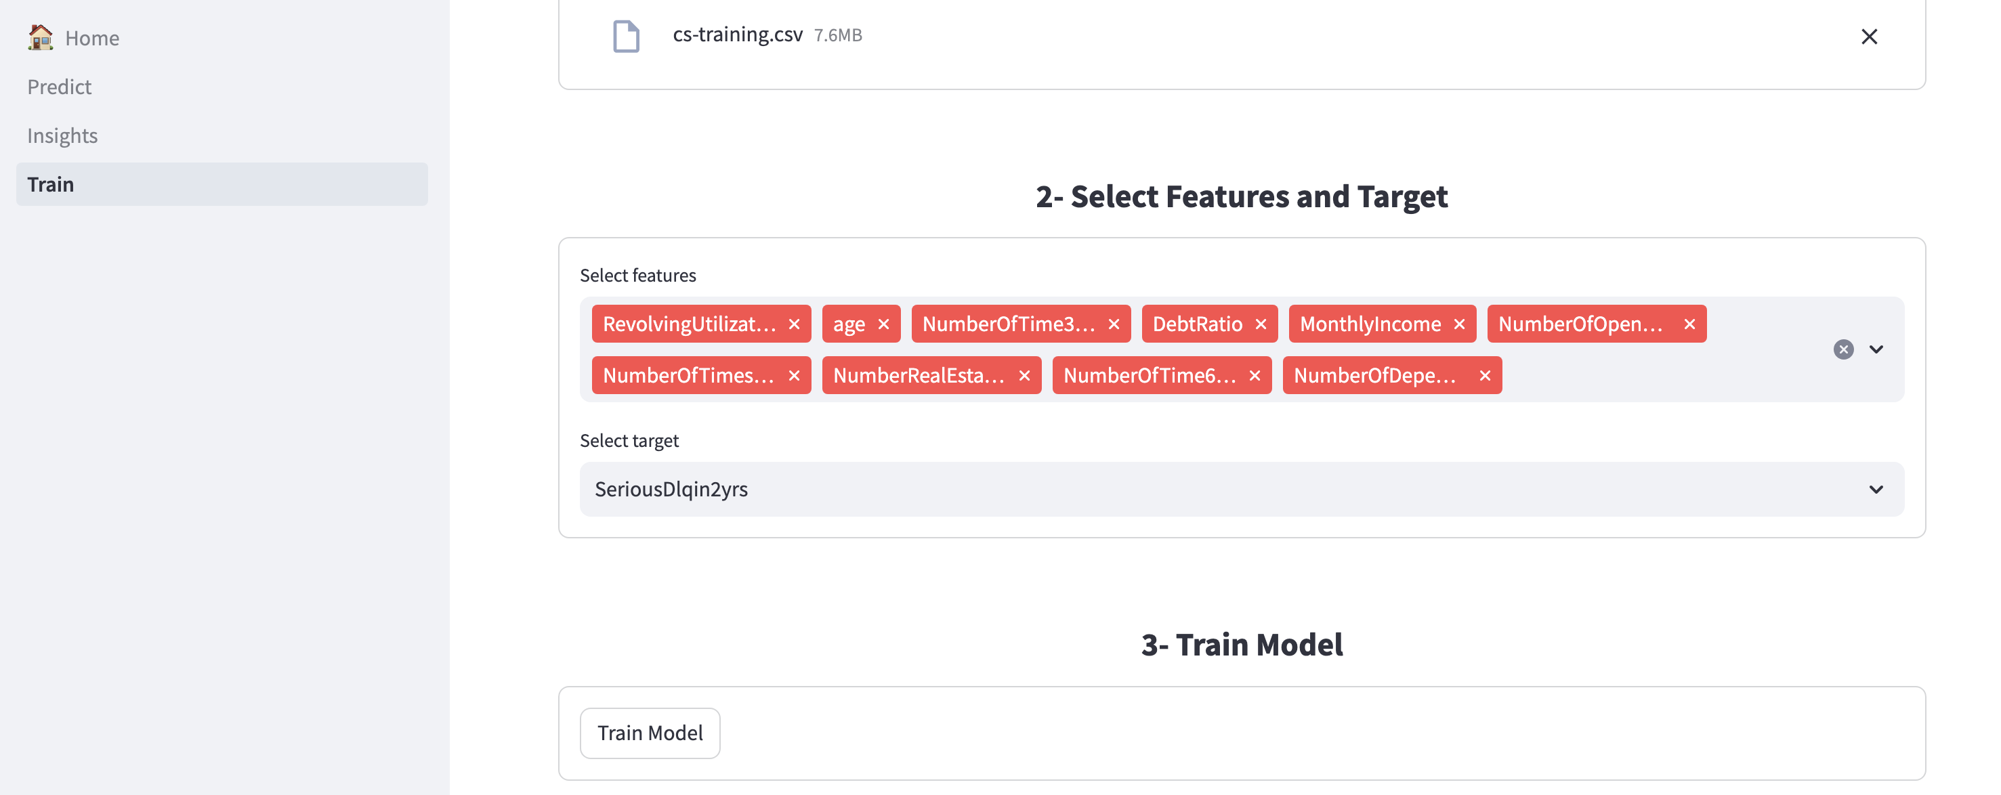
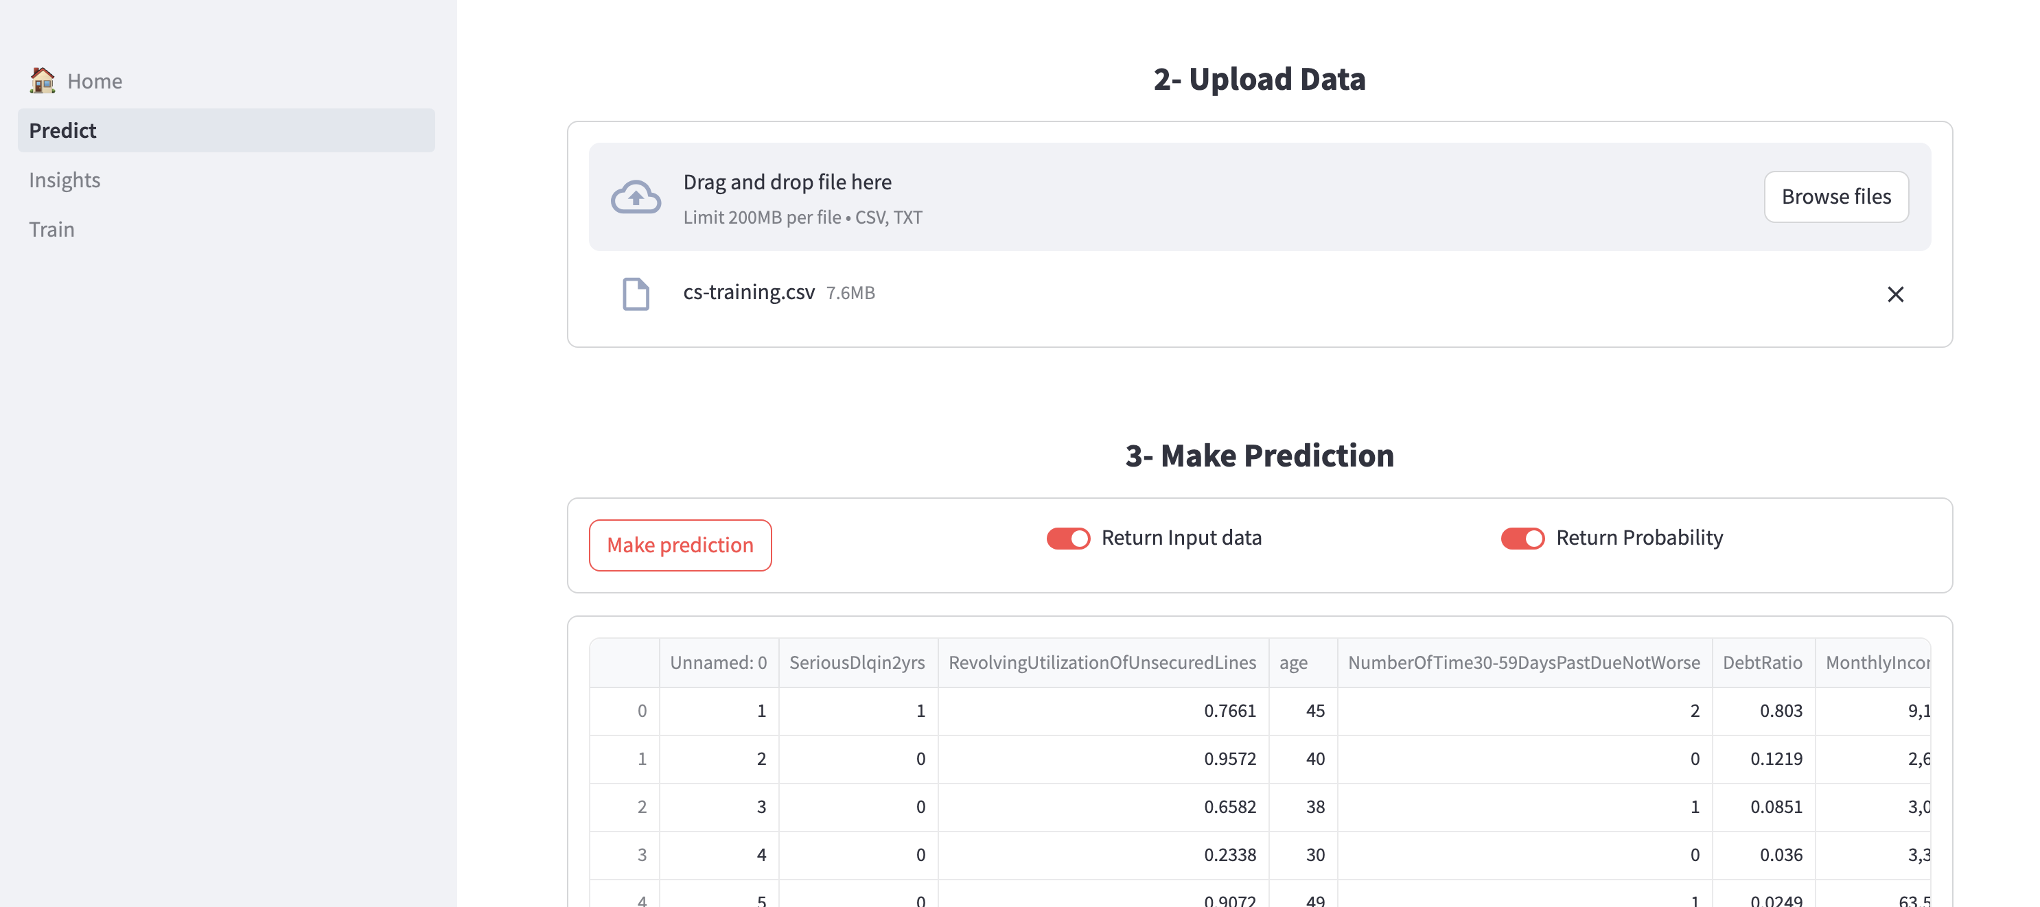
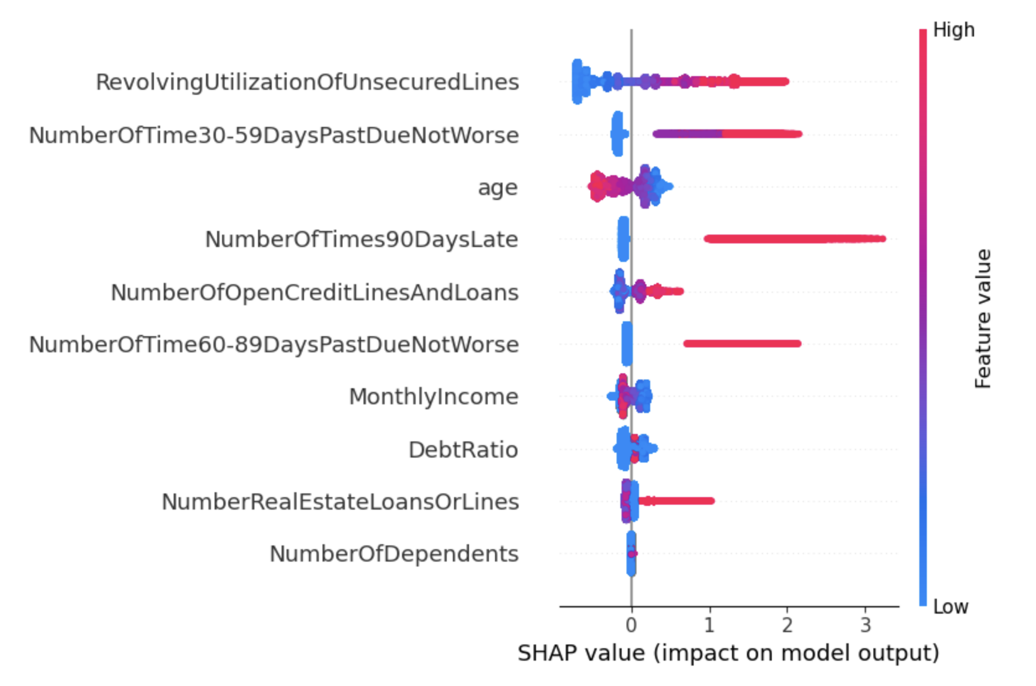
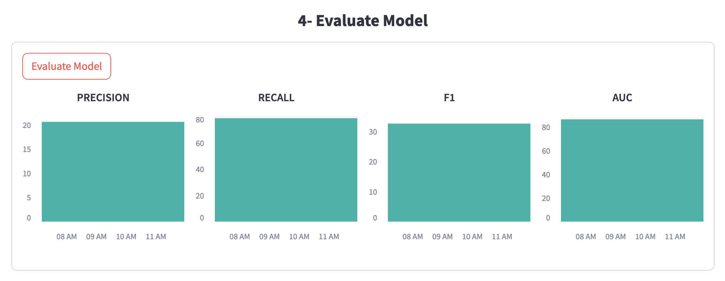
SOLUTION – STREAMLIT APP (3/3)
To leverage the Machine Learning model developed, we've crafted a Python application that addresses the specified requirements outlined in the introduction in a simple and interactive manner.
While this application primarily serves two use cases, it also boasts additional features.
USE CASE 1: BATCH PREDICTION
USE CASE 2: INSIGHTS
OTHER FEATURES
This feature allows users to predict credit defaults for multiple clients simultaneously.
Users upload a CSV file containing client data, and the application uses the Machine Learning model to predict which clients are likely to default on their credit.
This functionality provides users with explanations for the predictions made by the Machine Learning model.
It helps users understand the reasons behind each prediction, offering insights into the factors contributing to the likelihood of credit default.
Re-train and save new Machine Learning on user request.
Monitor Model performance over time.
Documentation for better use

Slide 10





DEPLOYMENT
TEST LOCALLY
PACKAGE
GITHUB
DOCKER
RUN
Test the solution localy to ensure that all features work as expected and that there are no bugs or issues.
Once testing is complete, solution should be packaged. This involves organizing application files and dependencies into a coherent structure and make sure all necessary files, including configuration files and assets, are included.
Code: source code files for the application.
Data: store any data files used by your application such as ML models.
Pages: contains files that allows to display different section of streamlit app.
Main.py: main entry point of the application.
requirements.txt: file that lists the dependencies required by the application.
Dockerfile: file that contains instructions for building a Docker image for the application.
README.md: file that provides documentation and information about the project.
Push packaged solution to a public GitHub repository. This step helps in version management, collaboration, and backup of codebase.
Create a Docker image of the application. Docker allows to package the application and its dependencies into a lightweight, portable container. To do so, i wrote a Dockerfile that specifies the environment and dependencies needed to run the application.
The app Docker image is stored in public repository.
Docker image created helps us deploy the application to the desired environment. This might be a local server, a cloud platform, or a virtual machine.

Slide 11
















WHY USE DATAIKU
ALL IN ONE
AI PIONNER
Dataiku replaces a diverse tech stack by integrating data ingestion, preparation, visualization, machine learning, and deployment into one platform, streamlining workflows and enhancing collaboration. Here's how it consolidates multiple tools into a single solution:
Data Integration
Data Preparation and Cleaning
Exploratory Data Analysis (EDA)
Model Building
Dataiku pioneers AI by integrating advanced machine learning tools and automated workflows, enabling the application of cutting-edge algorithms and making sophisticated AI accessible to broader teams.
Collaboration and Version Control
Model Deployment and Monitoring
Scalability and Performance
Documentation
01
04
02
05
EVOLUTIVE
03
06
Dataiku is evolutive by seamlessly integrating with diverse data sources and technologies, allowing it to adapt to evolving business and tech needs while receiving regular updates to stay current with industry advancements.
All in one platform
Tech stack needed to deploy end-to-end solution
COST EFFECTIVE
Dataiku is cost-effective by combining multiple data functions into a single platform, reducing software and maintenance costs, while its scalability with big data technologies optimizes infrastructure expenses.
SUPPORT
Dataiku supports its clients with implementation and customer success managers, comprehensive training through Dataiku Academy, and a dedicated support portal. They also offer live chat, email support, and professional services for AI strategy and infrastructure optimization​
TIME TO MARKET
Dataiku accelerates time to market by offering rapid prototyping through AutoML and visual data preparation tools, enabling quick development and iteration of models. Its collaborative features enhance team productivity, reducing delays and streamlining the path from development to deployment.

Slide 12




CONCLUSION
CURRENT SOLUTION RESPONDS TO THE INITIAL PROBLEM
P
I
C
F
PREDICTION
INSIGHTS
CONTINOUS IMPROVMENT
FURTHER
The model effectively predicts credit delinquency with a high accuracy score.
It accurately identifies 47% of all actual delinquent cases.
Of the borrowers flagged by the model as delinquent, 41.5% are indeed delinquent.
Several challenges limit the model's predictive capacity, including data imbalance and feature quality.
The model identifies the most influential features and their impact on delinquency.
The likelihood of default within the next two years increases significantly if a person frequently exceeds their credit limits.
A higher number of instances where the borrower has been 90 days or more delinquent substantially raises the probability of default.
It also identifies features that are not significant.
The number of dependents does not significantly affect the probability of default.
Monthly income is not a determining factor in the likelihood of default.
Handling data drift.
Continuous improvement.
Detecting and fixing biases.
Incorporating new information.
Adapting to regulatory changes.
Enhance the Machine Learning model
Collect additional relevant data.
Perform more feature engineering.
Experiment with new models.
Fine-tune the model.
Enrich the Application
Segment customers by profile.
Enable scenario simulation with manual feature input and results.
Develop more use cases
Offer personalized financial products.
Automate credit decisions.
Evaluate risk policies.
Provide training and raise awareness.

